Slide 1
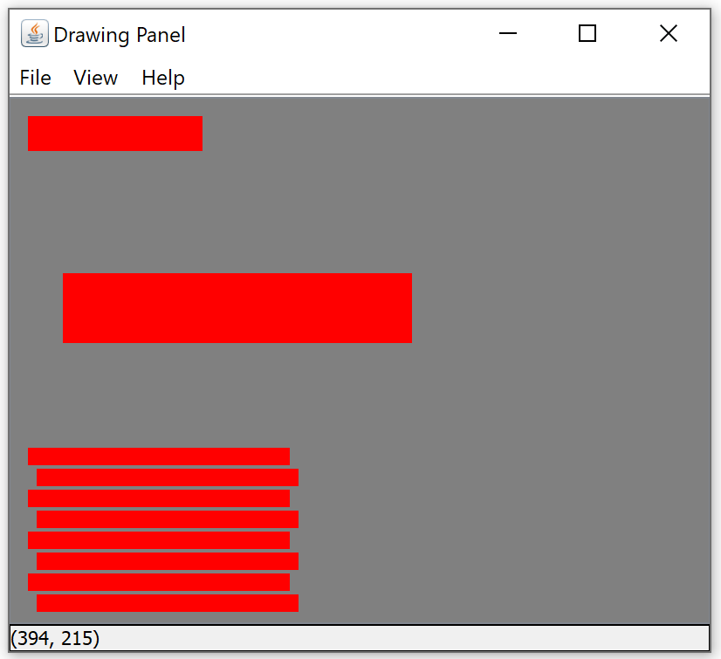
1
Row
x | 10
y | 10
width | 100
height | 20
Row
1
Row composition:
Defined by location and size
Size defined by width and height
2
Row
x | 30
y | 100
width | 200
height | 40
Row
2
3
Grid
x | 10
y | 200
# pairs | 4
offset | 10
row width | 150
row height | 10
gap | 2
Grid
3
Grid composition:
Rows are in pairs
Each row is separated by a little bit
Alternating rows are offset
Let’s define size by # pairs and row size

Slide 2
1
Row
x | 10
y | 10
width | 100
height | 20
Plan:
Number methods needed?
main
drawRow(x, y, width, height)
drawGrid(x, y, numPairs, offset, rowWidth, rowHeight)
main:
set up drawingPanel and Graphics objects, background gray
drawRow(10, 10, 100, 20)
drawRow(30, 100, 200, 40)
drawGrid(10, 200, 4, 10, 150, 10)
drawGrid:
for each pair
drawRow(x, y, width, height)
y += rowHeight + MORTAR
drawRow(x+offset, y, width, height)
y += rowHeight + MORTAR
drawRow:
Set color to red
fillRect(x, y, width, height)
3
1
2
Row
x | 30
y | 100
width | 200
height | 40
(400x300)
2
3
Grid
x | 10
y | 200
# pairs | 4
offset | 10
row width | 150
row height | 10
gap | 2
3
Expected output is in PlayRowGridOutput1.png

Slide 3
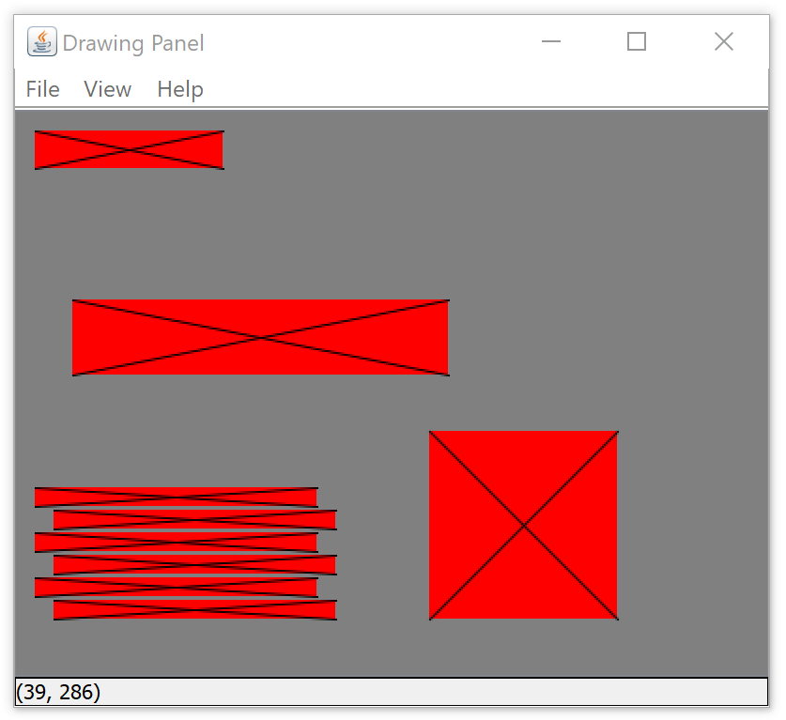
For the second step:
add a 4th figure, info below
draw a black X on each row from top left corner to bottom right
Expected output is PlayRowGridOutput2.png
4
4
Row
X | 220
y | 170
width | 100
height | 100
Row

